Slide 1
GENRE-ATION (Music Genre Recognition) Under Guidance of: Prof. K. P. Kamble
Presented by:
Himanshu Donadkar (2016BTECS00063)
Ritik Poshattiwar (2016BTECS00081)
Abhinavram Ananth (2016BTECS00103)

Slide 2
Contents
Introduction
Previously Done Work
Objectives
Implementation
Applications

Slide 3
Introduction
Music– An important form of data
Music– {Album, Artist, Year, Genre, Song length}
Genre plays an important role in Music Information Retrieval
Genre– Depends on the metadata provided by artist.
Why depend on metadata?

Slide 4
Case Studies
Genre Classification for Musical Documents Based on Extracted Melodic Patterns and Clustering
Accuracy: 70.6%
Technologies: ANN/KNN
Deep Music Genre
Accuracy: 58.9%
Technologies: RNN

Slide 5
Literature Survey
Neural network ideas are now being applied to music classification
GTZAN, MSD, MusiXmatch, MagnaTagATune and Last.fm tag datasets were used in many papers.
Recognition using ML through Gaussian mixture model (GMM), support vector machine(SVM), online dictionary learning (ODL), RNN(Recurrent Neural Network).
Many of the research papers had accuracies around 60-70%.

Slide 6
Objectives
To achieve higher accuracy using Deep Learning through CNN
Why CNN?
Increases accuracy
Reduces time to classify
To publish a Web-based application

Slide 7
Implementation
Record audio through microphone
Convert to Spectrogram using Keras/Tensorflow

Slide 8
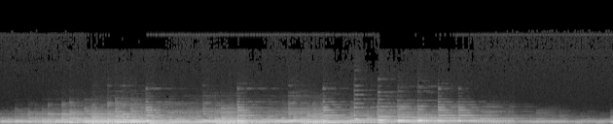
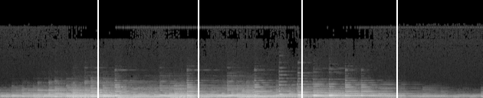
Implementation
Conversion into Spectrogram
Slicing the Spectrogram

Slide 9
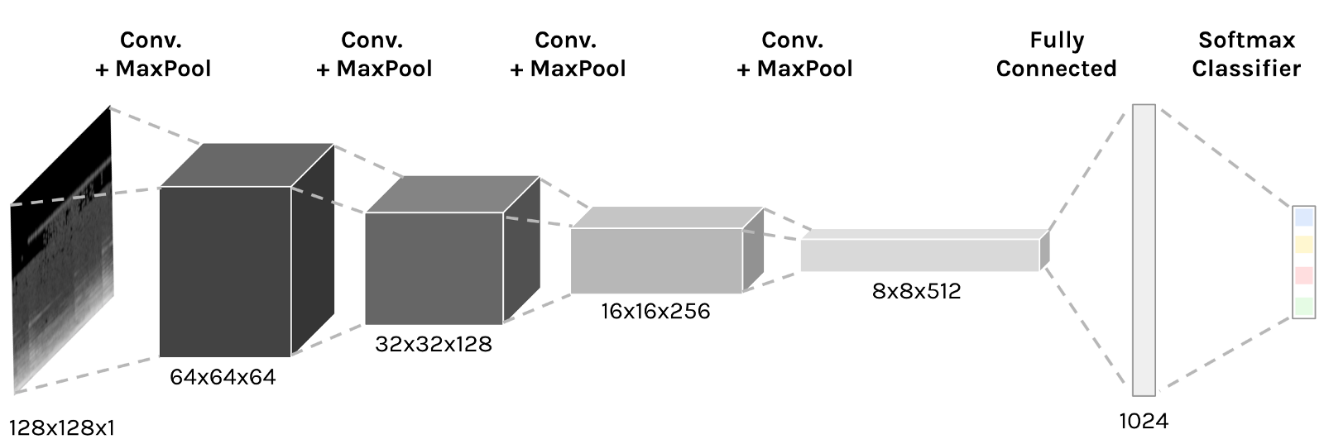
Implementation
Classification using CNN

Slide 10
Implementation
Voting

Slide 11
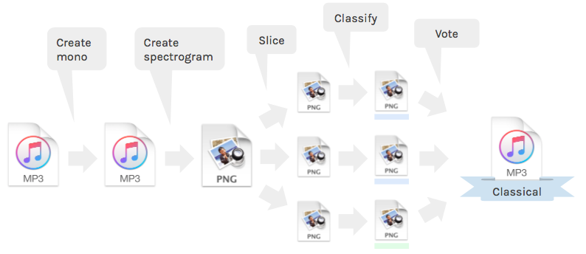
Complete Work Flow

Slide 12
Applications
To organise the database of raw samples of music
Music recommendation and discovery
Music as Assistive technology (Specially-abled/Educational use)

Slide 13
THANK YOU

